Slide 1
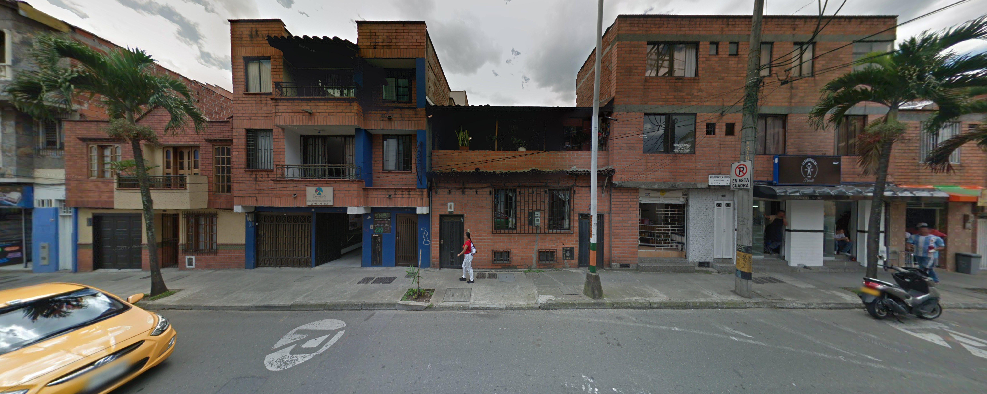

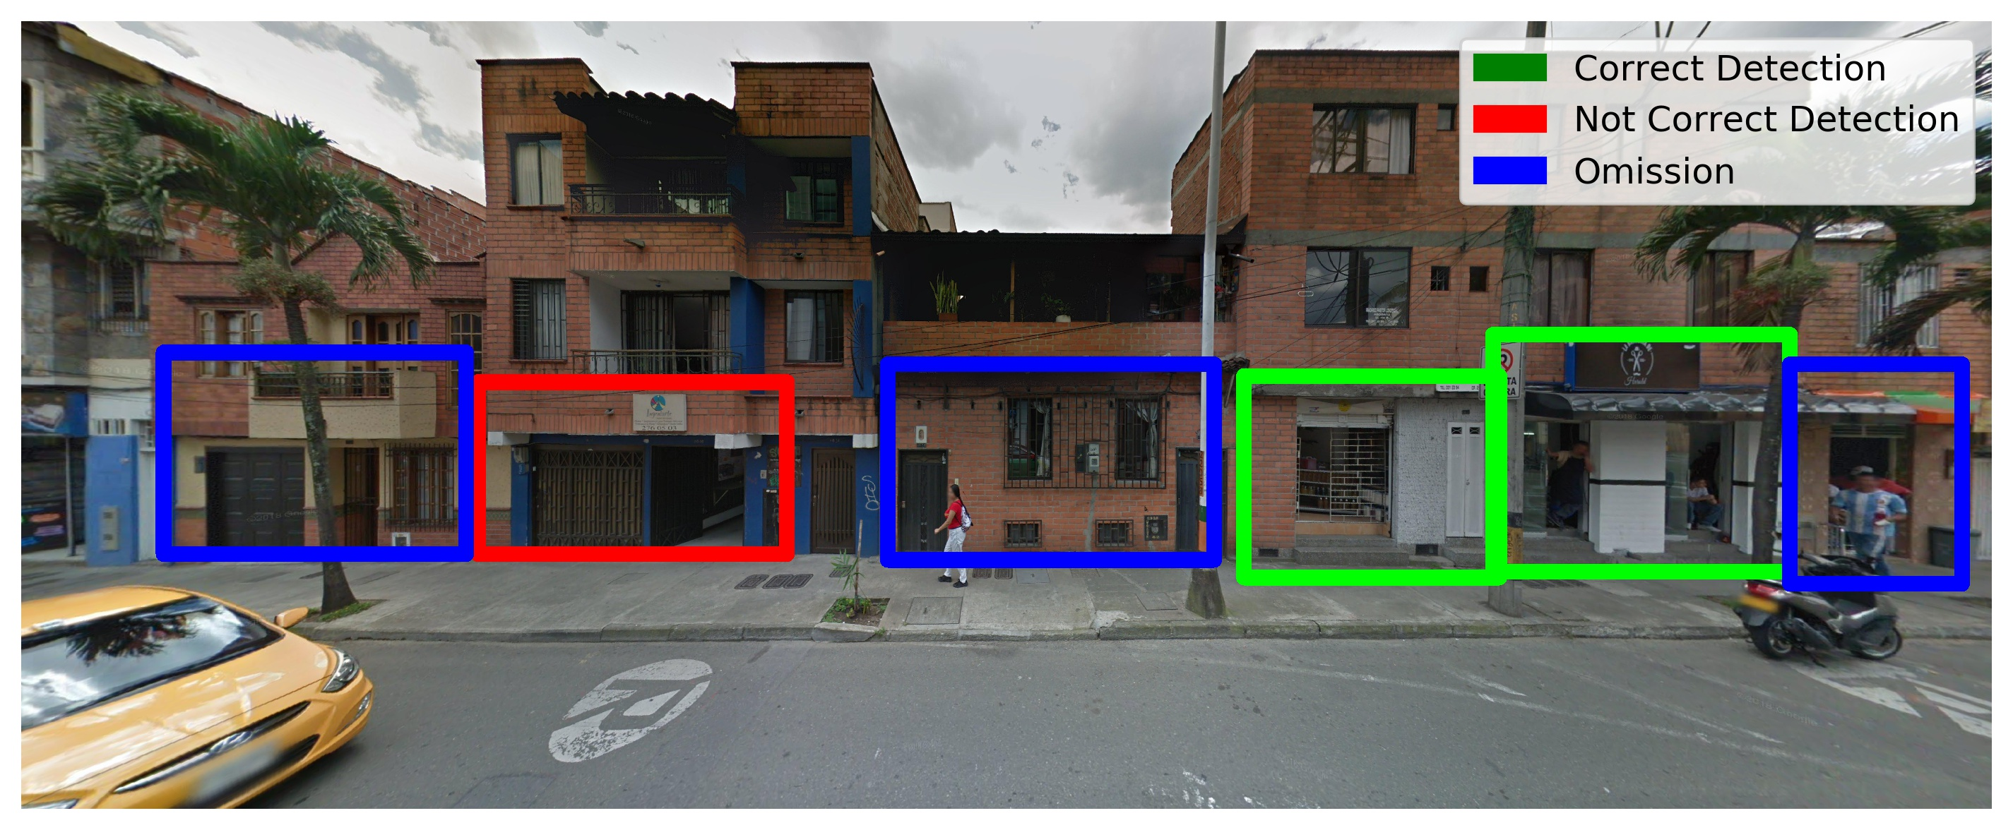
prediction.py
Visible Commerce Detection labels
Lateral Facade or Street view image
Visible Commerce Detection on Image

Slide 2
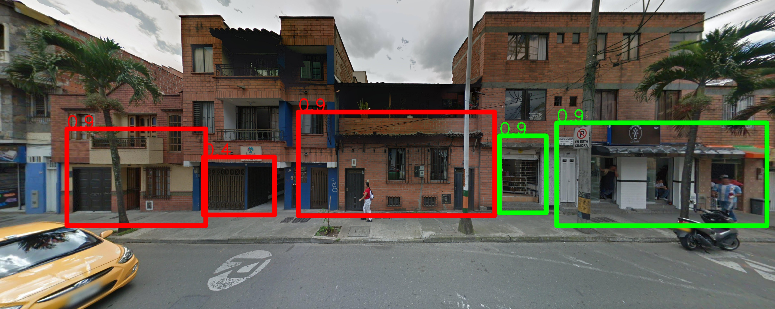
Image with building facades
prediction.py
Visible Commerce manually labeled
Visible Commerce Detection labels
Visible Commerce Detection on Image
model_performance.py
Table with performace metrics in commerce counts
%

